Slide 1

Impact of Social Media

Slide 2

#Today’s Contents
Overview of Social Media
Who’s on Social Media?
Developing a Social Media Strategy
Tips, Basics and Best Practices
How to Measure Success
Social Media’s Growth
Benefits and Challenges

Slide 3
Overview: #What is Social Media?
Social media refers to online tools and services which allow an exchange of ideas, information, videos, pictures, and graphics — just about anything you can name.
Social media also allows easy sharing and distribution of existing content to others so that professional work can be shared through networks.

Slide 4
#Overview: Types of Social Media Services
Bookmarking Sites and Social News Sites (Digg)
Blogs and Microblogs (Twitter, Tumblr)
Social Networking Sites (Facebook, Google+)
Shopping Sites (Amazon)
Multimedia Sharing (YouTube, Flickr)
Virtual Worlds (World of Warcraft, Second Life)

Slide 5
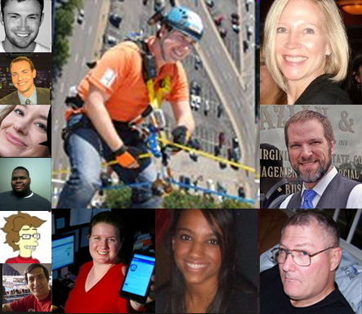

#Who’s on Social Media?
Organizations
Individuals

Slide 6

#Developing a Strategy
Define your audience
Adopt a point of view
Allocate resources

Slide 7

#Tips for contents
Make it easy and non-threatening for your audience to participate
1
Write content that’s worth sharing
2
Acknowledge and recognise your audience
3
Integrate all of your marketing efforts
4
Don't try to keep up with the Jones’
5
Be entertaining, informative, and most importantly genuine
6

Slide 8

#The Basics
Don’t duplicate your Web site, brochure, newsletter
2
Start with your friends
3
Embrace your audience
4
Keep it personal, real & authentic
5
Use often
6
Build maintenance time into your schedule
7
Encourage participation
1

Slide 9

Top 5 best practices:
Do some Spring cleaning!
Beef up your information section.
Be active/share.
Follow industry influencers and companies/groups of interest.
Quality vs. Quantity

Slide 10

Top 5 best practices:
Who do you want to be?
Think SEO (Search Engine Optimization).
Be active/share.
Follow industry influencers and companies/groups of interest.
Aim to chat, not sell.

Slide 11

Top 5 best practices:
Think SEO (Search Engine Optimization).
Be active/share.
Follow industry influencers and companies/groups of interest.
Aim to chat, not sell.
Don’t talk about your new shoes!

Slide 12

Tips for all platforms:
Have a consistent brand
Engage
If it’s posted, it’s public
A little self-promotion goes a long way, but braggers are equally if not more annoying online than they are in person.
You don’t have to be everywhere
Connect virtually. Bond locally.

Slide 13
How to Measure Success
Use of Analytics tools
Number of Shares
Number of Visits
Become trending stories

Slide 14
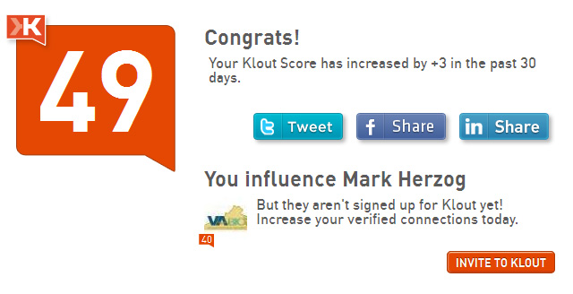
How to Measure Success

Slide 15
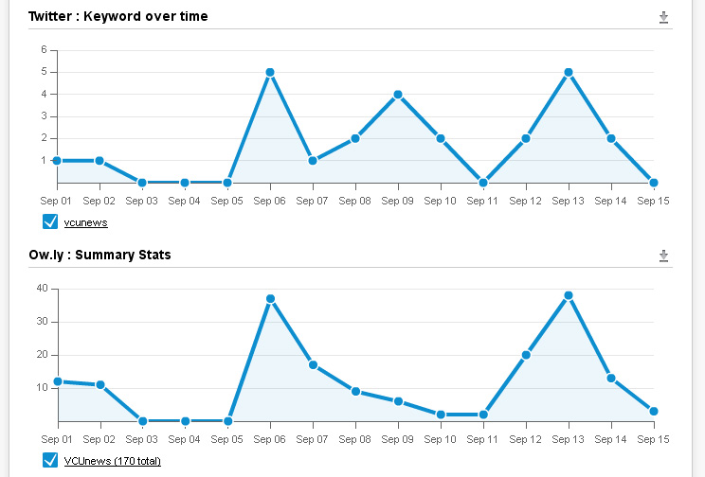
How to Measure Success

Slide 16

Benefits of Social Media
Marketing
Selling and promoting the university to students
Academics, research, sports
Brand recognition
University accomplishments
Selling and promoting the university to alumni, businesses and potential donors
Human resources
Job postings

Slide 17
Benefits of Social Media
Communication tool
Direct customer communication
Speed of feedback/results
Low cost
Reach
Credibility
Customer service

Slide 18
Social Media Risks and Concerns
Reputational and financial risks
Information security risks
Legal risks

Slide 19
Regulatory Risks and Concerns
FERPA, Family Educational Rights and Privacy Act
HIPAA, Health Insurance Portability and Accountability Act
Require the non-disclosure of personal private student and patient data.
Require notification if personal private data is disclosed

Slide 20
Regulatory Risks and Concerns
Section 230 of the Communications Decency Act of 1996
Section 230(c)(1) provides immunity from liability for providers and users of an "interactive computer service" who publish information provided by others:
This means your ISP or the social media provider is not responsible for anything that is posted on their web site (except for what provider posts).

Slide 21
Reputational and financial risks
Making the news for all the wrong reasons
Security breaches
Posting of personal private data
Posting of embarrassing information (data, reports, photos, videos)
Re-posting of data: e-mails, memos, reports, employee rants can be resent by recipients to a much larger and unintended audiences.
“Name squatting” or “Brand hijacking” when a third party uses your company name or logos without your permission in social media.
Consequences
Cost of corrective actions and damage control
Loss of donations, grants
Lawsuits

Slide 22
Information security risks
Introduction of viruses/malware to the corporate network
Security breaches
Loss of productivity / downtime
Consequences
Reputational damage
Regulatory fines

Slide 23
Legal risks
Disclosure of sensitive or protected information:
An employee could unwittingly click on links to spam or phishing schemes or download malicious code on to the university network
Regulatory violations
Discovery and preservation issues:
Ensure that data can be preserved, retrieved and produced if required
Just because an attorney is cc’d, does not make it privileged
If a privilege exists, it can be lost:
Once communications are shared with others, any privilege of confidentiality will be lost.

Slide 24
Business Risks
Here are five primary business risks associated with the use of social media:
Introduction of viruses/malware to the corporate network;
Brand hijacking, such as a brand being impersonated on Twitter;
Unclear or undefined content rights to information posted on social media sites;
Unrealistic customer expectations of service through the ability to communicate with companies online 24/7; and
Noncompliance with record management regulations because of mismanagement of electronic communications.

Slide 25
Social Media Risk Controls
Policies and procedures address at least:
What is social media
Acceptable and authorized use of social media
Posting rules/requirements for data, videos
What is not allowed (rants, threatening, hateful or sexual content, bad mouthing employees, etc.)
Rules for friending between employees, supervisors, students and faculty
Regulatory requirements
Copyright rules
Intellectual property rules

Slide 26

Social Media Risk Controls
Communications:
Communicate to all personnel (and students) the social media policies and procedures
Periodic communications regarding social media acceptable use
i.e. if an employee uses the university’s name for a personal post are they required to include a disclaimer.
Communicate when and how to notify management of policy violations.

Slide 27
Social Media Risk Controls
Training
Social media use training for users that will use social media as part of their job function or for research purposes
Provide a webinar on social media use, risks, and your policies and procedures
Social media use and regulatory requirements / restrictions (clearly defining that posting private patient or student is not allowed)

Slide 28
Social Media Risk Controls
Information Technology Controls
Antivirus/malware software
Firewalls
Logging and monitoring
Security controls implemented on your social media site
Scanning the social media sites for your data
You can set up Google for “Social Mention” alerts when your university or president name is used

Slide 29

Questions Time

